Slide 1
Web Development with F#
Ryan Riley and Daniel Mohl
@panesofglass and @dmohl
wizardsofsmart.net
Blog.danielmohl.com

Slide 2


Who Are These Guys?
Ryan Riley and Daniel Mohl
ryan.riley@panesofglass.org
dmohl@yahoo.com

Slide 3


Slide 4


F# Fundamentals
What is F#?
F# Interactive
Values and Functions
Types and Type Inference
Lists and Sequences
Pattern Matching
Units of Measure
Mixing Classes and Functions

Slide 5
Why F# in Web Development?
F#/JavaScript Commonalities
Web solutions are more complex than ever
Concise yet readable syntax
Great features for building highly scalable, modern web solutions (async workflows, MailboxProcessors, etc., etc.)
It’s now easier than ever with F# Tools for VS2012 Express for Web.

Slide 6

Building an ASP.NET MVC 4 Solution
Looking at a C# example

Slide 7

Building an ASP.NET MVC 4 Solution
Looking at a C# example
Create an F# equivalent solution

Slide 8
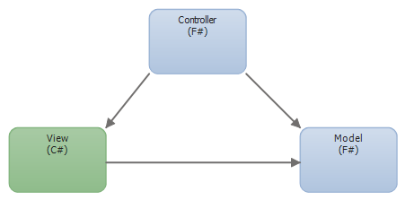
Solution Breakdown

Slide 9

Lab Time
Your Turn

